Slide 1

Inclement Weather Preparedness plan
Massachusetts state budgetary office
Notes:
Ladies and gentlemen I thank you for giving us your valuable time to present a state wide initiative, to respond to and distribute resources around the state of Massachusetts for faster and more efficient response to inclement weather and weather emergencies.

Slide 2
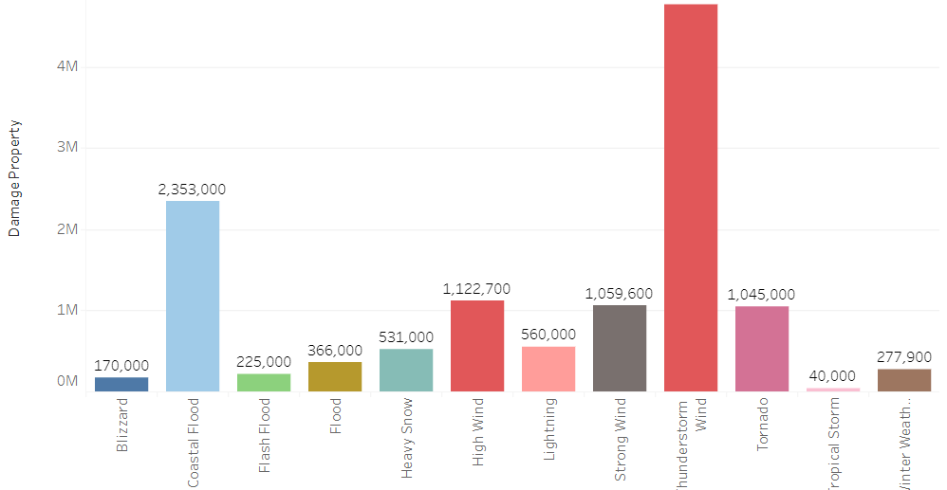
Damages in USD by Event type
Notes:
-Massachusetts is a temperate climate state
-Emergencies arise each year
-Most common emergencies
-Millions of dollars worth of damage
-Should not be ignored

Slide 3
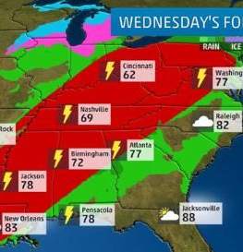
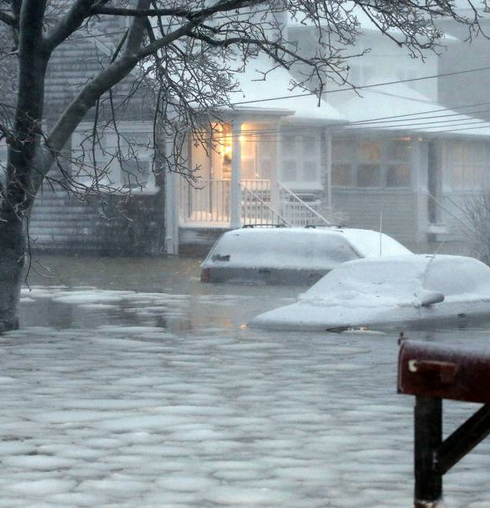
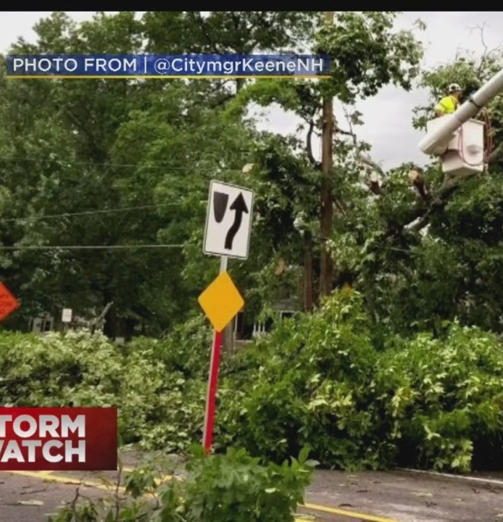
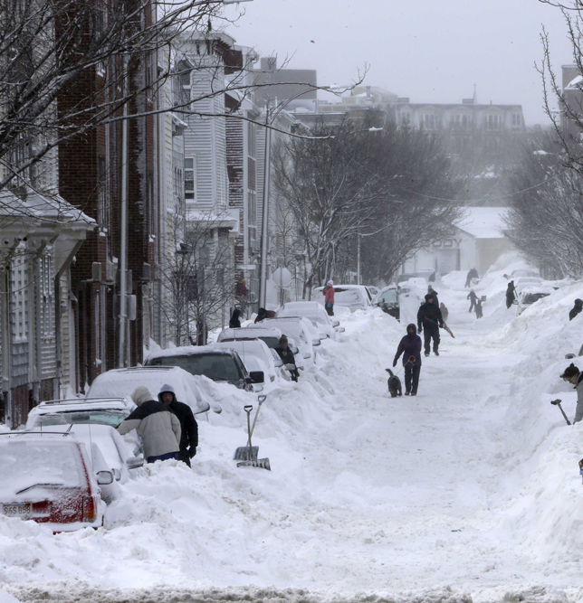
Addressing weather emergencies effectively
Notes:
- Most common emergencies
1. Wind
2. Snow
3. Flash/coastal floods
4. Winter storms
Effectively preparing the resources based on historical data analysis – dashboard
Creation of new tools to respond to inclement weather
Reduction in response times, and decrease in budget expenses due to more efficient deployment of resources

Slide 4
Strategic Resource Deployment
-Localize equipment
01
-Learn from historical data
02
-Specialize personnel
03
-Provide emergency tracking tools
04
-Prepare the public
05
Notes:
- Localize equipment: EX: no need for flooding prevention in regions that do not flood historically
- Learn to anticipate the damage based on season, and which regions are most likely to suffer
- Specialize state emergency personnel in certain geographical work- EX: coastal flooding
- Dashboard for EMA
- Public out reach via pamphlet/website

Slide 5
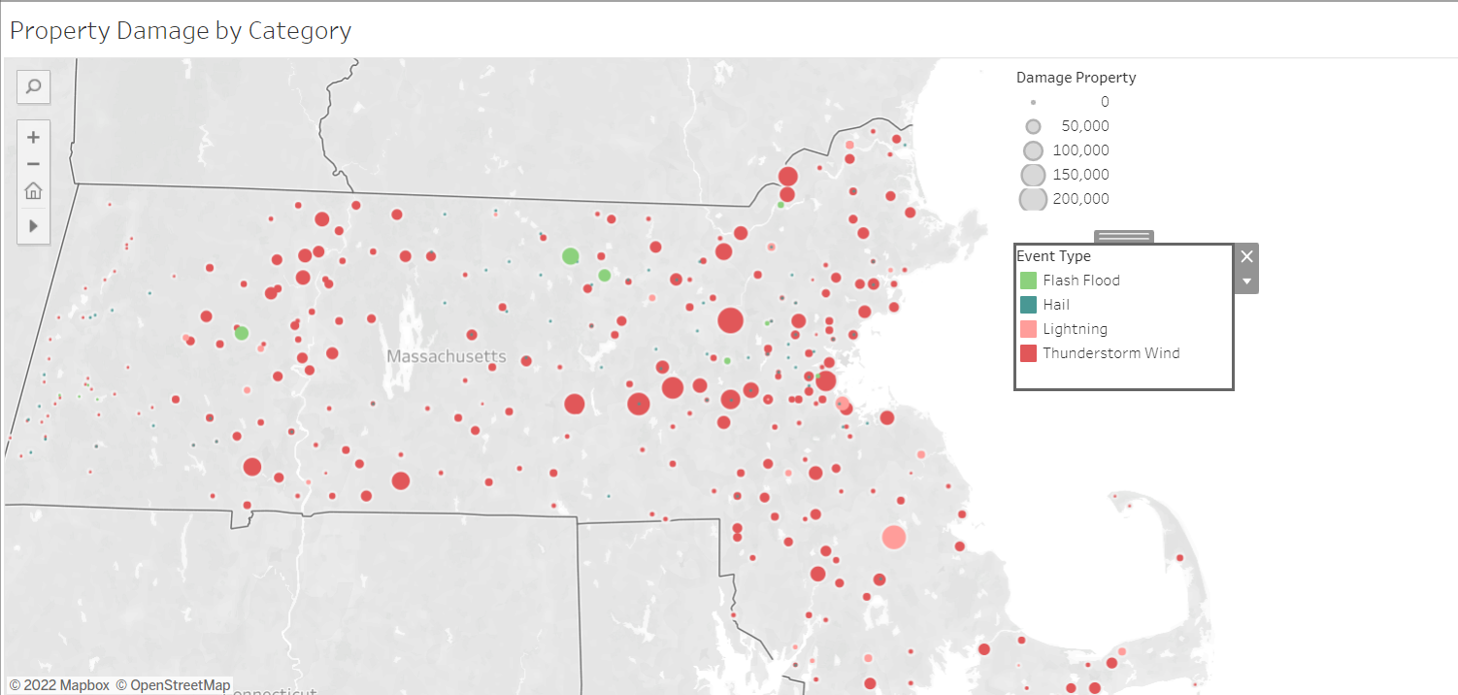
All of us are affected!
Notes:
Nearly all of MA towns are affect by inclement weather
Common property damage events:
1. Flash flood
2. Hail
3. Lightning
4. Thunderstorm wind

Slide 6
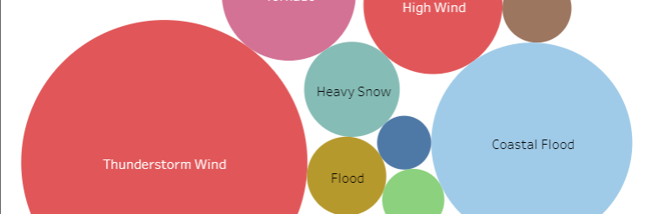
How to prepare
Notes:
Plan with historical data in mind
EMA – Dashboard
Public Outreach
Who is affected? - Everyone
Certain geographical regions are affected more
Population density vs incident rates

Slide 7
Thank you
Feedback:
Email: MAweatherproject@gmail.com
Phone: 1-800-XXX-XXXX
Address: 1 Massachusetts Lane, Boston, MA 01000
Point of contact:
Lead Designer – Marek Krawczyk
Notes:
This is it for our short presentation
Resolved matters
Next steps
1. Implement budgetary plan
2. Feedback
3. Creation of Dashboard and pamphlet
4. Timeline

